Slide 1
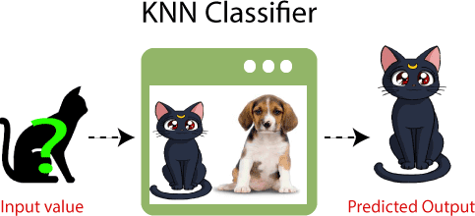
What is K-NN Algorithm?
KNN Classifier
Input Data
Output Data
Abu Bakar Siddique Mahi
Image: javatpoint.com

Slide 2
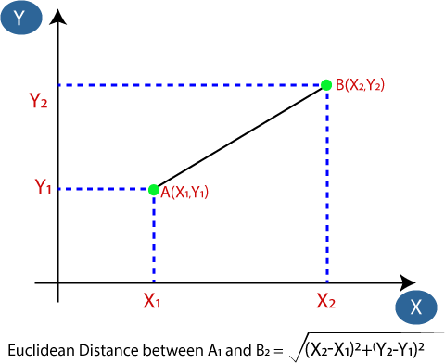
K-NN Algorithm: Classification
Image: javatpoint.com

Slide 3
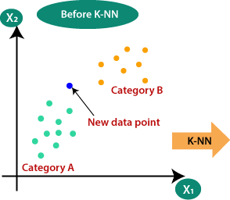
Why do we need a K-NN Algorithm?
Image: javatpoint.com

Slide 4
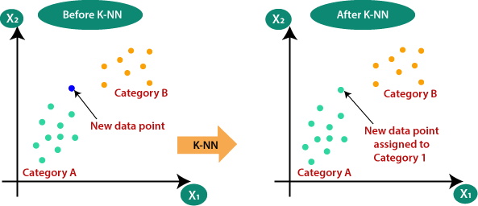
Why do we need a K-NN Algorithm?
Image: javatpoint.com

Slide 5
Steps: K-NN Algorithm
Steps: The K-NN working can be explained on the basis of the below algorithm:
Step-0: Calculate the Euclidean distance from unknown data point.
Step-1: Sort all data point based on distance.
Step-2: Take the K nearest neighbors as per the calculated Euclidean distance.
Step-3: Among these k neighbors, count the number of the data points in each category.
Step-4: Assign the new data points to that category for which the number of the neighbor is maximum. Step-5: Our model is ready. Let’s Predict -

Slide 6
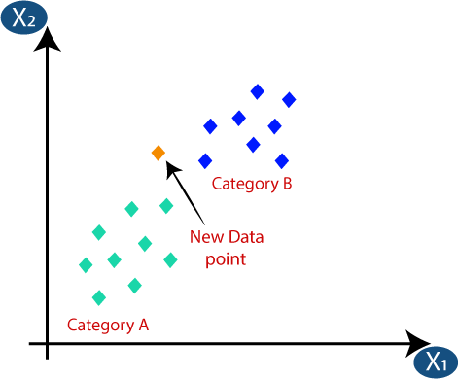
K-NN Algorithm: Classification
Image: javatpoint.com

Slide 7
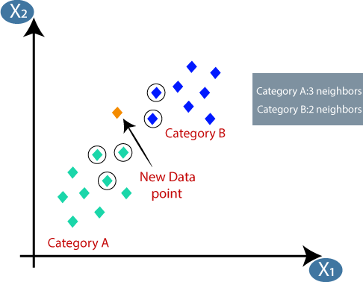
K-NN Algorithm: Classification
Image: javatpoint.com

Slide 8
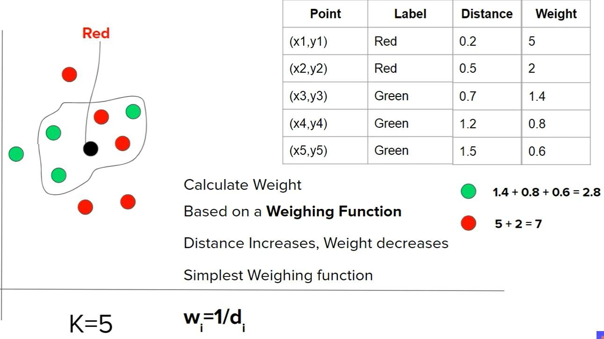
K-NN Algorithm: Weights{‘uniform’, ‘distance’}
Image: Google.com

Slide 9
Let’s Calculate for Regression!
K-NN Algorithm: Regression

Slide 10
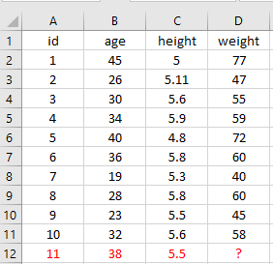
K-NN Algorithm: Regression

Slide 11
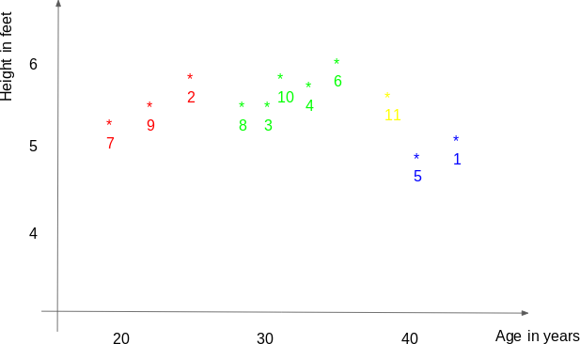
K-NN Algorithm: Regression
Height
Prediction
Age
Analyticsvidhya.com

Slide 12
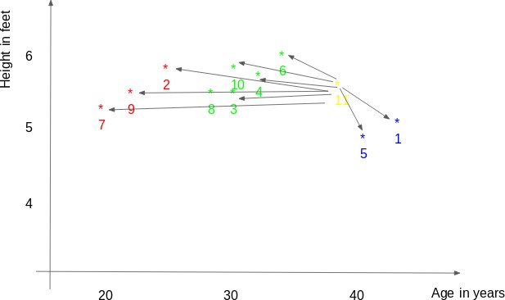
K-NN Algorithm: Regression
Height
Age

Slide 13
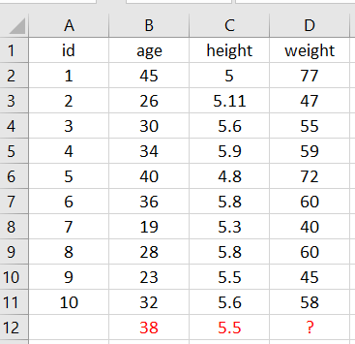
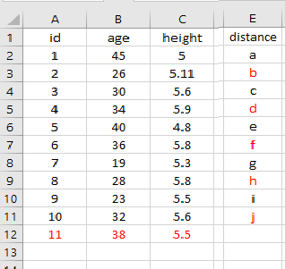

Distance,
K-NN Algorithm: Regression

Slide 14
Distance,
K-NN Algorithm: Regression
Sequence:
a > e > f > d > j > c > h > b > i > g

Slide 15
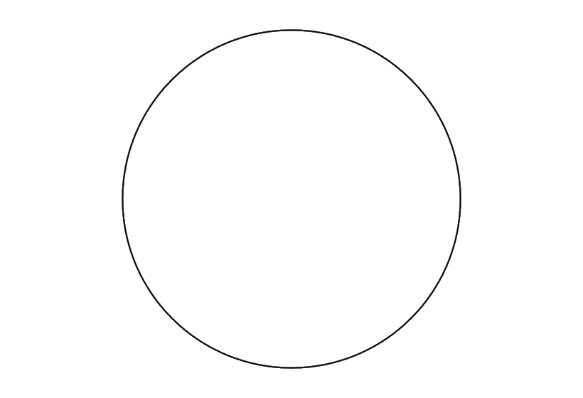
K-NN Algorithm: Regression
Height
K = 3
Age
Analyticsvidhya.com

Slide 16
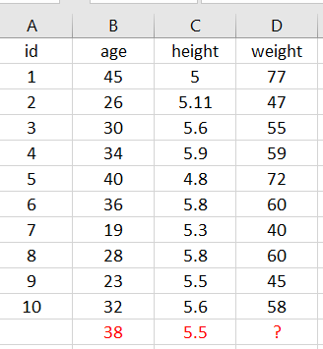
K-NN Algorithm: Regression
Height
K = 3
Mean: (77+72+60)/3
= 69.6 kg
Age
Analyticsvidhya.com

Slide 17
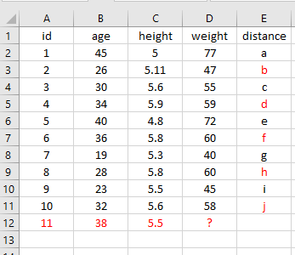
K-NN Algorithm: Regression
Sequence:
a > e > f > d > j > c > h > b > i > g
Height
K = 5
Mean: (77+72+60+59+58)/5
= 65.2 kg
Age
Analyticsvidhya.com

Slide 18

Let’s Do Self Assessment!
K-NN Algorithm: Regression

